Slide 1
Hackathon challenge 2022
final round
EESTEC LC Belgrade
Team Hyperparameters
Teodora Srećković, School of Electrical Engineering, University of Belgrade
Strahinja Nikolić, School of Electrical Engineering, University of Belgrade
Vojin Ivković, School of Electrical Engineering, University of Belgrade

Slide 2
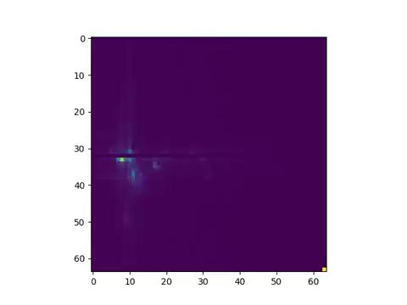

Data collecting and preprocessing steps
We did several tests and different configuration of the setup.
Our recordings lasted for around 10 to 20 seconds.

Slide 3
Data collecting and preprocessing steps
We removed external noise from the data to obtain the best results.
We scaled the data and used SMOTE oversampling technique.
We used sum of Doppler-Range maps from multiple recivers
We used many different features such as such as max value of the frame, the sum of all values that are in the matrix which represents the image, velocity of the object etc.
We obtained the rest of the features using PCA technique.

Slide 4
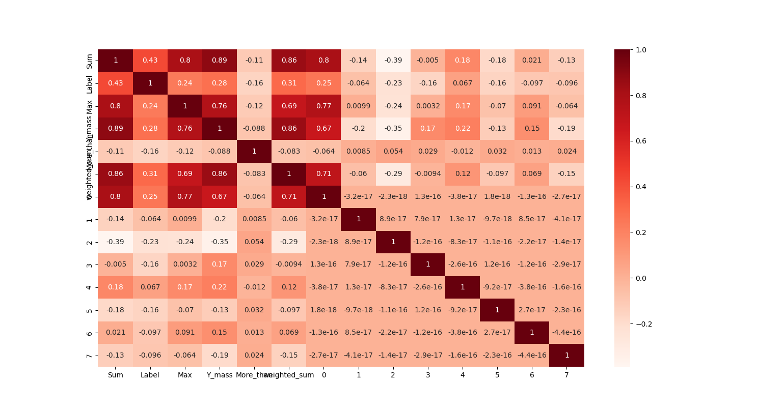

Slide 5
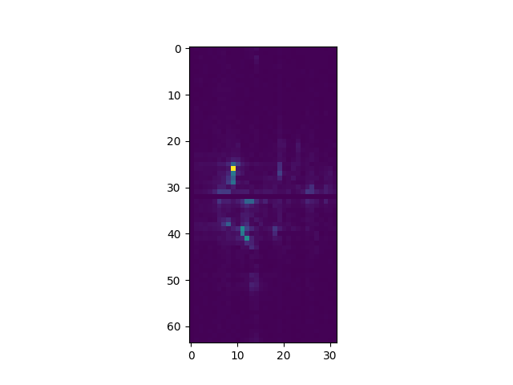
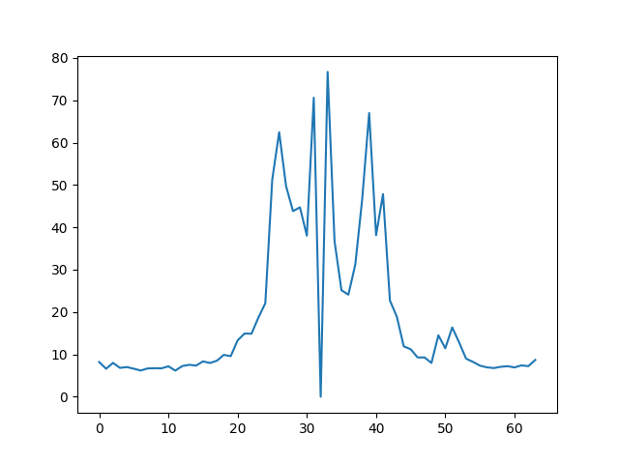
Feature selection example

Slide 6
Machine Learning Model
We used xGboost classification model
GridSearchCv to determinate values of hyperparametes

Slide 7
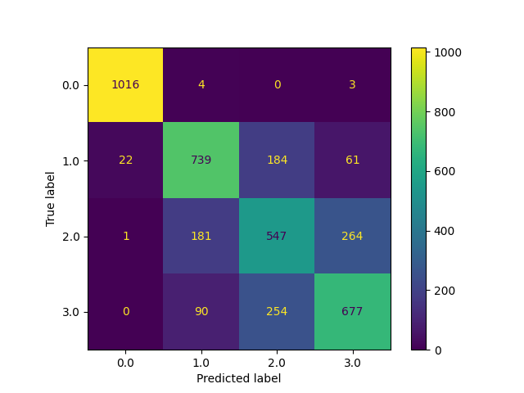
Results
F1 score: 0.73

Slide 8
Future work
Imporivng feature selection
Getting more data from different rooms and more testing

Slide 9
Thank you for your attention

